Slide 1

AtliQ Hotel A case study to visualize Key Performance Indicator of Hospitality domain.

Slide 2
Business objective
AtliQ is a company that owns multiple hotel chains across various cities of India
The Managing director / CEO of AtliQ wants to incorporate ‘Business and Data Intelligence’ to identify and track the source of revenue for AtliQ hotels
Hence, it is decided to develop a KPI Dashboard for AtliQ, using May-22 to July-22 data, which can help track its revenue sources and other relevant KPIs across various dimensions
It’ll help the management take strategic business decisions based on the insights generated from the dashboard

Slide 3
Problem statement / Project scope
Identify the data sources pertaining to revenue management
Clean and model the data as per requirement for analysis
Create a revenue dashboard that measures important KPIs
Relevant filters need to provided to slice and dice the data
The dashboard should depict both high level and granular insights

Slide 4
Solution approach
There are 5 tables provided for tracking revenue, 3 dimension tables (date, hotel, room) and 2 fact tables (bookings, aggregated bookings)
Power BI was the tool used for creating the visualization/dashboard
The data was imported, analysed and transformed as per necessity within Power Query
The relationships between the tables were created within Power Pivot

Slide 5
Solution Approach
Data cleaning / Transformation
Data modelling
Measure creation in DAX
Dashboard building

Slide 6
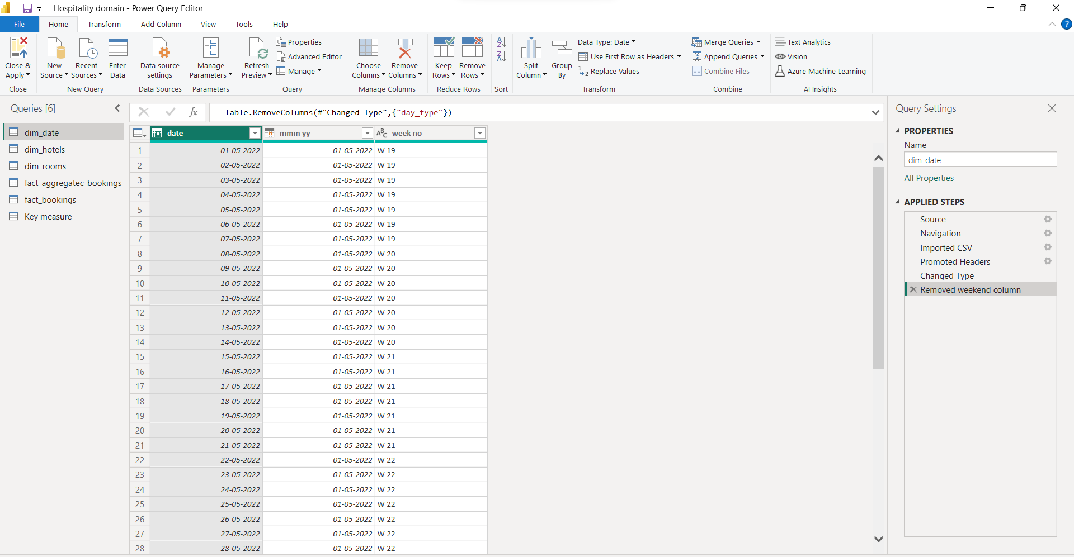
Extract, Load and Transform data(ETL) in Power Query

Slide 7
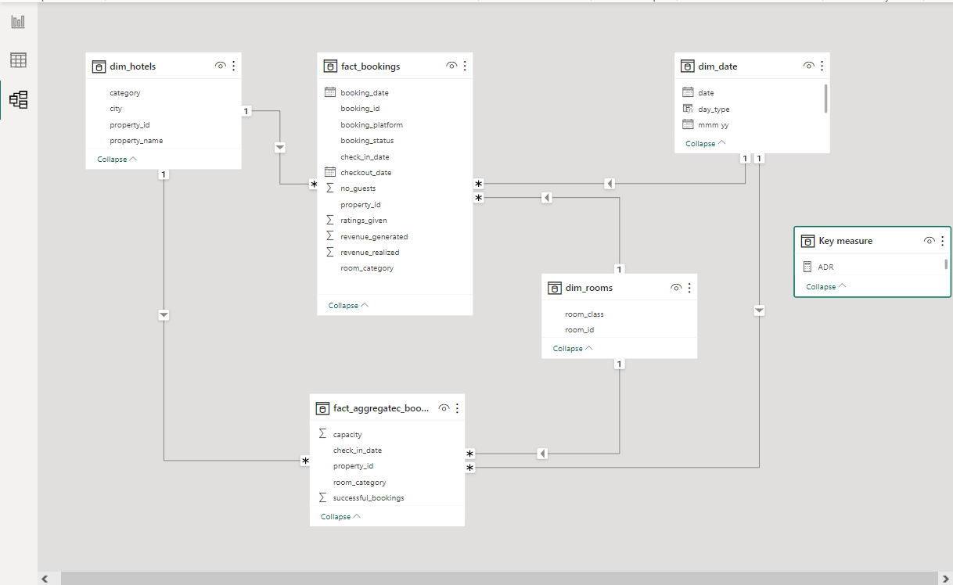
Data Modelling

Slide 8
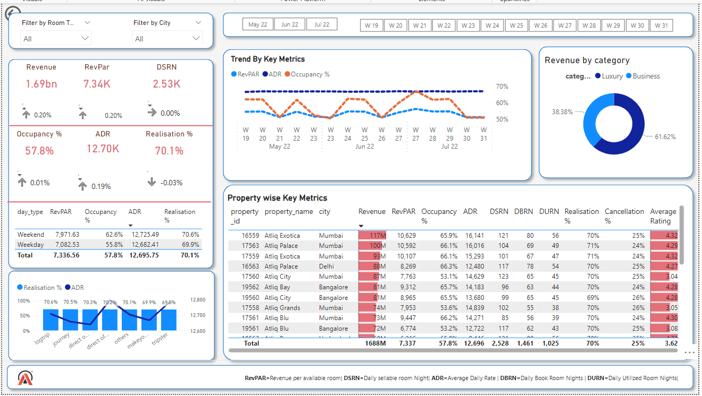
Dashboard

Slide 9
Overview of Dashboard
Card visuals exhibit Key Performance Indicators (KPIs):
Revenue Breakdown by Category:
Donut chart visualizes revenue segregation between Luxury and Business categories.
Property-wise Metrics Display:
Table showcases all key metrics categorized by property
4. Trend Analysis Visualization:
Line chart demonstrates correlations among RevPar, ADR, and Occupancy %.
5. Booking Platform Insights:
Line and Clustered Column chart visualizes Realisation % and ADR per booking platform.
Each feature provides in-depth insights into revenue, room metrics, trend analysis, and booking platform performance, facilitating comprehensive data assessment and decision-making.

Slide 10
Features of the dashboard
A bunch of card visuals were placed in the left to show the values of important KPIs
The following filters were provided to slice and dice the data:
Room Type
City
Month
Week Number
The visuals are interactive in nature
Tooltips pop-up when hovering over a visual for more information about the data point

Slide 11
Key Insight: 1
The consistent Revenue per Available Room suggests a static pricing approach rather than dynamic pricing within the hotel. In the hotel industry, pricing undergoes significant fluctuations between weekdays and weekends, prompting the necessity for an evolved pricing strategy by the management.
While weekly occupancy varies, the unaltered RevPAR implies a fixed pricing strategy. This discrepancy emphasizes the imperative need to transition from a static pricing model to a more adaptable dynamic pricing approach. The persistence of fixed pricing strategies underscores the opportunity to shift towards dynamic pricing to effectively align with changing occupancy patterns and optimize revenue potential.

Slide 12
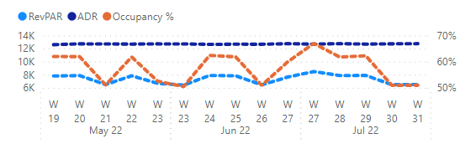

Slide 13
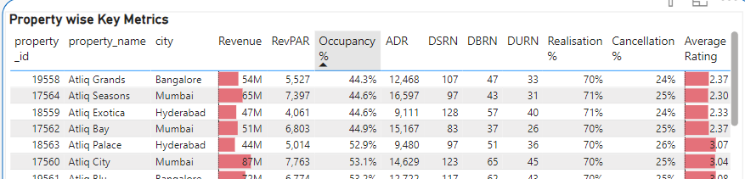
Insight No. 2
As occupancy % also shows that lower occupancy shows in that hotel which have lower rating means rating is also one of the influential parameters for the oveall performance of the hotel. Company should rigorously shows online as well as offline review of the customer whether it about food or services so that company can improve the occupancy % which will improve the revenue of the company.
As low rating also shows higher cancellation percentage also so company need to focus to revive revenue

Slide 14
Insight No. 3
The company should ensure consistent updates of their content across multiple booking platforms where the hotel is listed. Inconsistencies between online listings and actual offerings can lead to booking cancellations. Keeping content updated is a crucial factor influencing the variation in booking percentages across different platforms.

Slide 15
Link for the live Dashboard
https://app.powerbi.com/view?r=eyJrIjoiY2FjM2Q3OWItMmRjMy00ZDVkLWJjOTktODIxNjhmMjMyYTE1IiwidCI6ImM2ZTU0OWIzLTVmNDUtNDAzMi1hYWU5LWQ0MjQ0ZGM1YjJjNCJ9

Slide 16
Thank You

